Slide 1

Hand Sign Language Interpreter (HaSLI)
By Ad Astra

Slide 2
INTRODUCTION
HaSLI is an app that can translate sign language into words. It is an app that easy to use by a lot of people.
It can help people to interact with mute people or they can use this app to learn the sign language.
This app also provided all the sign language alphabets. User can practice using this app.

Slide 3

OBJECTIVES
To help people understand the sign language.
To help people to communicate with mute people.
To help people learn and practice this language.

Slide 4
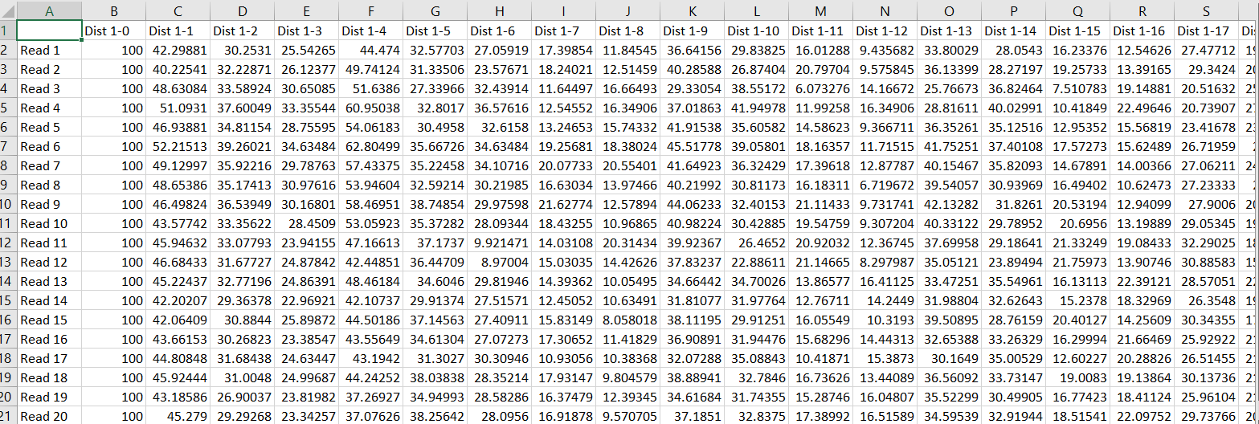
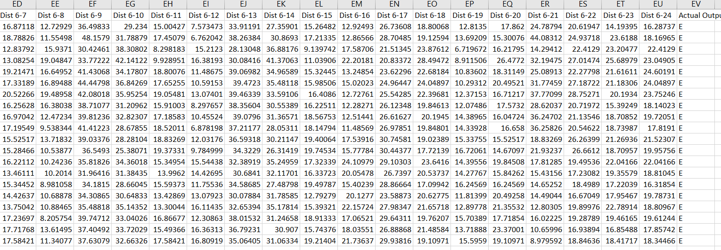
DATA
The data gathered by each of the members taking picture while doing the sign language
Each of them need to take 20 readings for each alphabets.
They did from the letter A to Z.
Each of the readings has its own value, the value is the data we needed.

Slide 5

DESIGN AND MODEL
Hand tracking:
Mediapipe library
Hand sign:
Neural network; 3 layers, input layer 150, hidden layer 150, output layer 26.
Activation function; sigmoid function

Slide 6
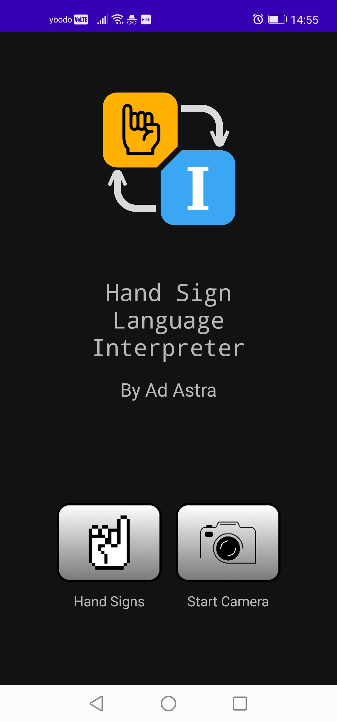
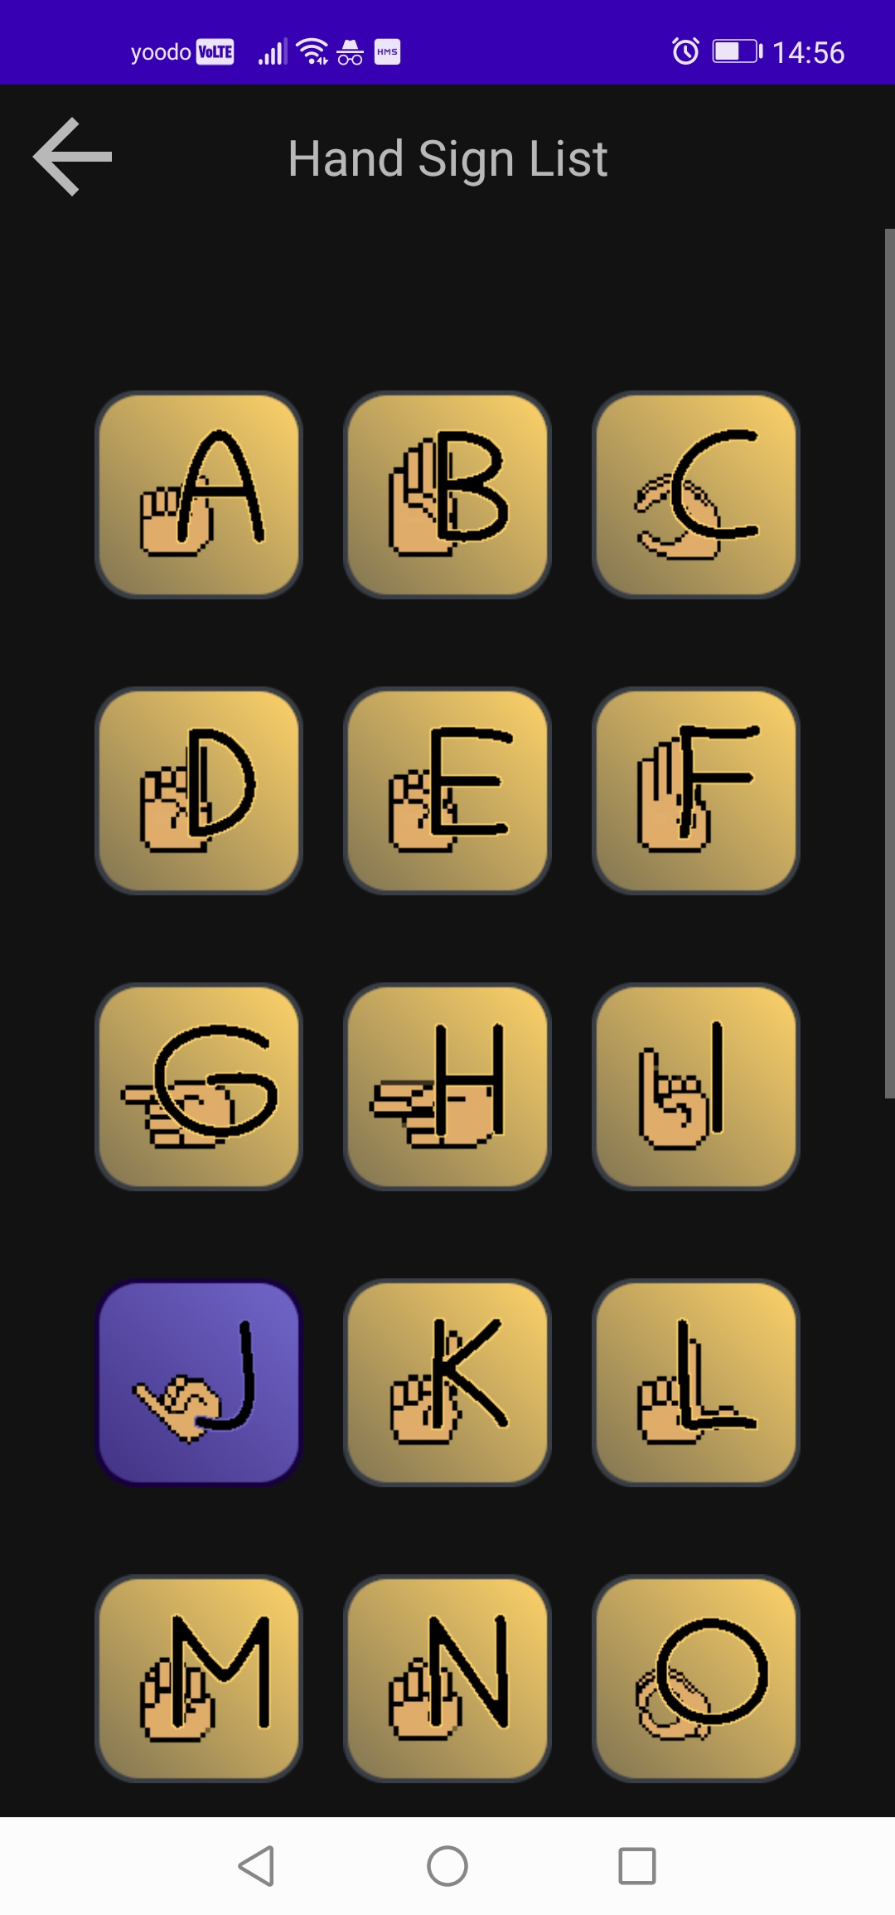
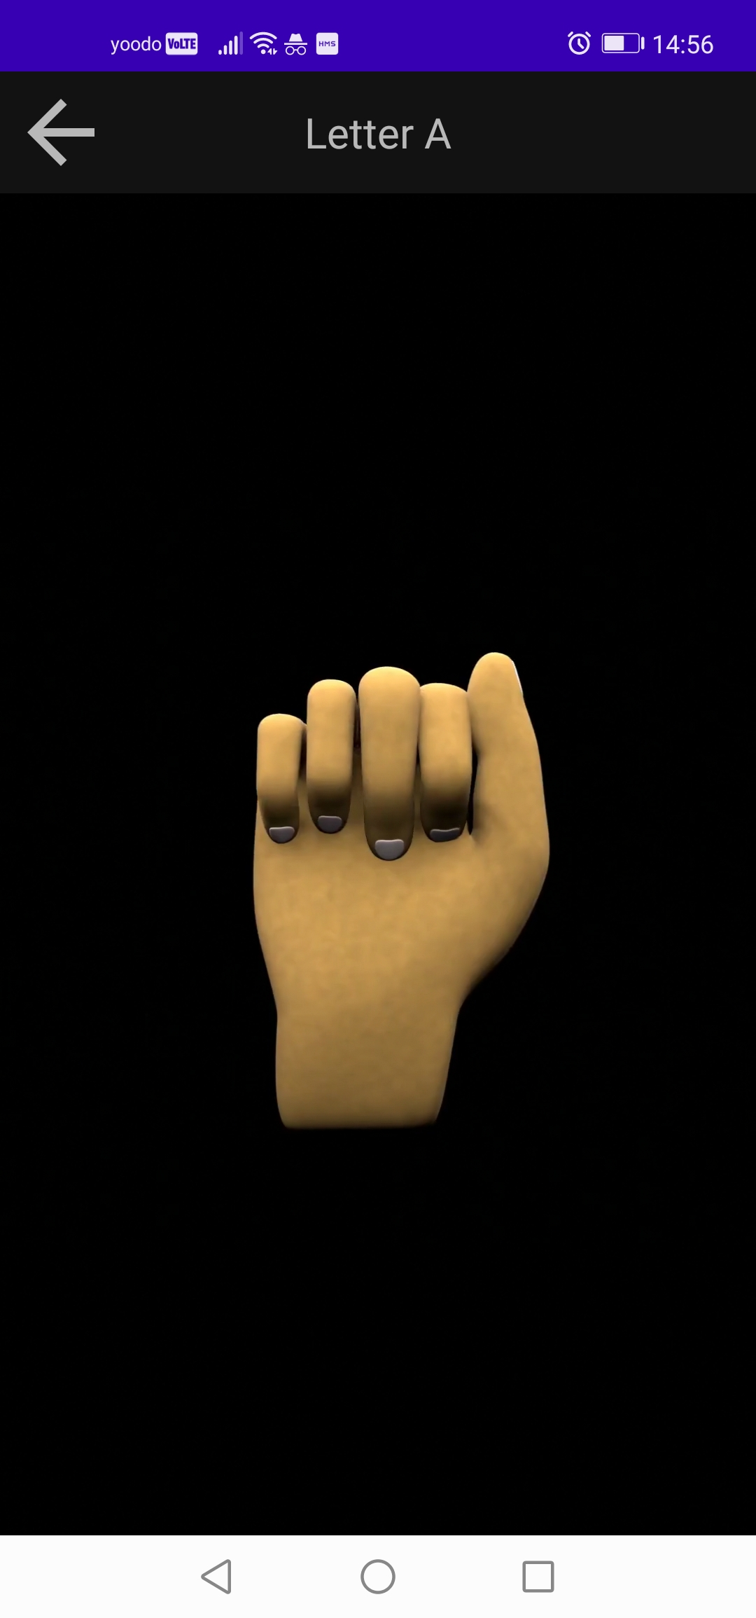
DEPLOYMENT
For this project we develop mobile-based app.
We mostly used android studio for the mobile app development.
We created models for each alphabets for the user to know each of the sign.

Slide 7
PROS AND CONS
PROS
CONS
User can make their own sentence using this app.
This app is beginner friendly; easy to use and not so complicated.
As of now, the app only cover the alphabets, the numbers and other words will be added soon.
Sometimes the app will not detect the user’s hand.
It will constantly detect user’s hand even if they no intention on doing so.

Slide 8

DEMONSTRATION

Slide 9
CONCLUSION
In short, this app can be very helpful for people who are in need to understand the sign language. This app is beginner friendly, and it can the steppingstone for someone who wants to learn this language.
This project has taught us many things on how to handle a project in a team. We learned that teamwork is very important in a project development to make sure the app published as planned.
We hoping that this app will be commonly used soon since it has a potential to help many people.

